Slide 1
INTRODUCTION TO
ALGORITHMS
FOURTH EDITION

Slide 2
LECTURE NOTES FOR CHAPTER 5
Probabilistic Analysis and Randomized
Algorithms

Slide 3
CHAPTER 5 OVERVIEW
Goals
Explain the difference between probabilistic analysis and randomized algorithms.
Present the technique of indicator random variables.
Give another example of the analysis of a randomized algorithm (permuting an array in place).

Slide 4
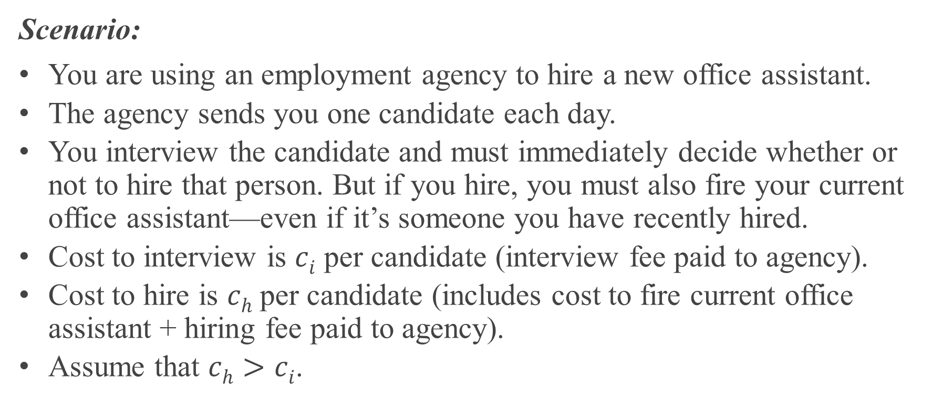
THE HIRING PROBLEM
Scenario:
You are using an employment agency to hire a new office assistant.
The agency sends you one candidate each day.
You interview the candidate and must immediately decide whether or not to hire that person. But if you hire, you must also fire your current office assistant—even if it’s someone you have recently hired.
Cost to interview is $ci$ per candidate (interview fee paid to agency).
Cost to hire is $ch$ per candidate (includes cost to fire current office assistant + hiring fee paid to agency).
Assume that $ch>ci$.

Slide 5
THE HIRING PROBLEM (continued)
Scenario:
You are committed to having hired, at all times, the best candidate seen so far. Meaning that whenever you interview a candidate who is better than your current office assistant, you must fire the current office assistant and hire the candidate. Since you must have someone hired at all times, you will always hire the first candidate that you interview.
Goal:
Determine what the price of this strategy will be.

Slide 6
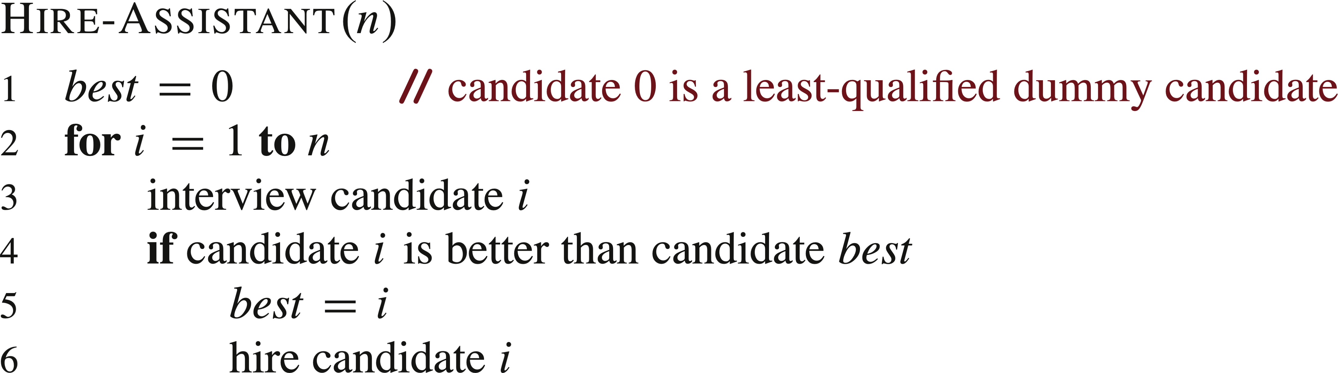

PSEUDOCODE TO MODEL THIS SCENARIO
Assumes that the candidates are numbered 1 to $n$ and that after interviewing each candidate, you can determine if they’re better than the current office assistant. Uses a dummy candidate 0 that is worse than all others, so that the first candidate is always hired.

Slide 7
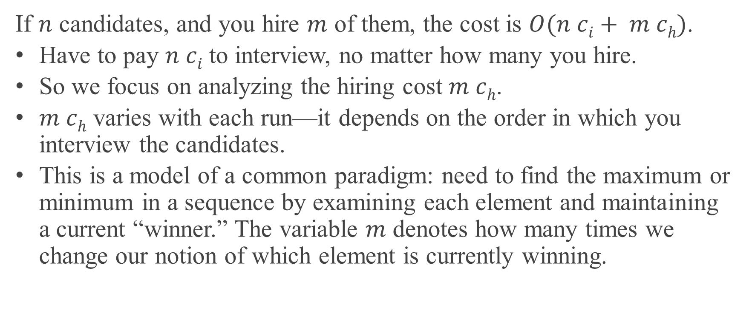
COST
If $n$ candidates, and you hire $m$ of them, the cost is $O(n ci+ m ch)$.
Have to pay $n ci$ to interview, no matter how many you hire.
So we focus on analyzing the hiring cost $m ch$.
$m ch$ varies with each run—it depends on the order in which you interview the candidates.
This is a model of a common paradigm: need to find the maximum or minimum in a sequence by examining each element and maintaining a current “winner.” The variable $m$ denotes how many times we change our notion of which element is currently winning.

Slide 8
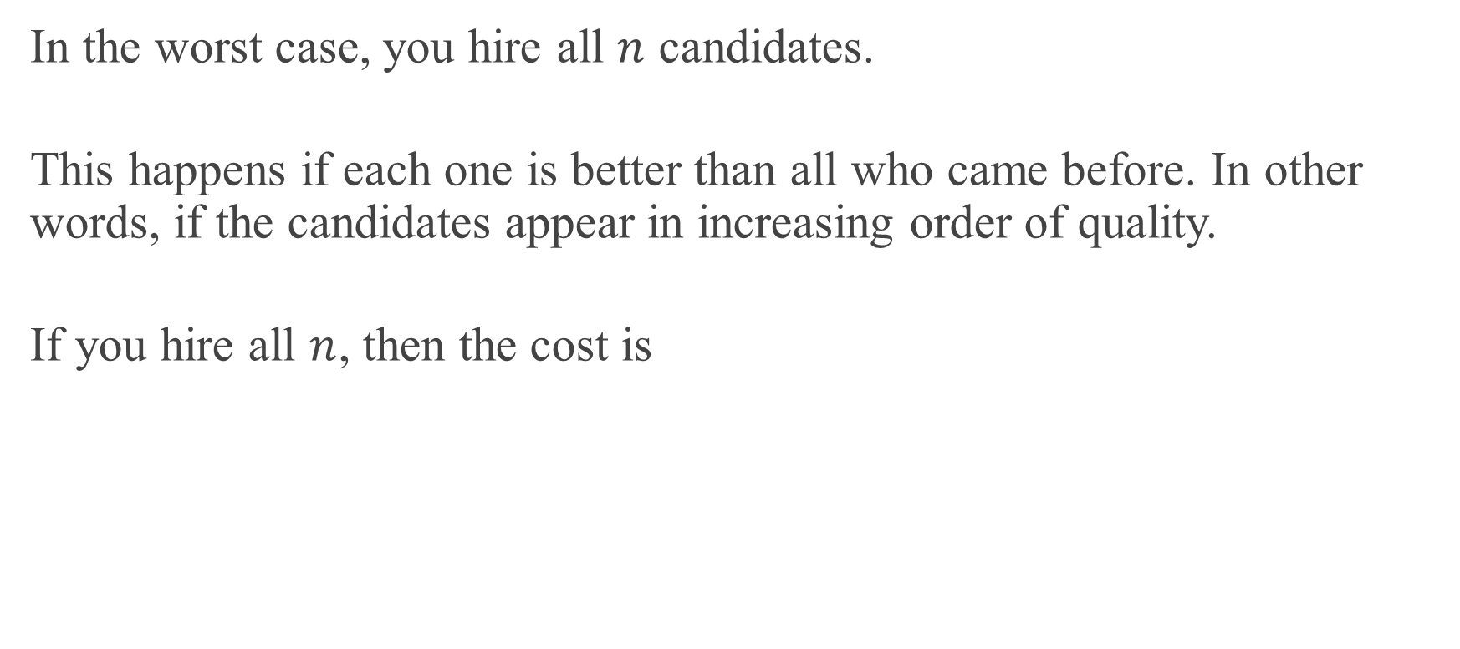
WORST-CASE ANALYSIS
In the worst case, you hire all $n$ candidates.
This happens if each one is better than all who came before. In other words, if the candidates appear in increasing order of quality.
If you hire all $n$, then the cost is

Slide 9
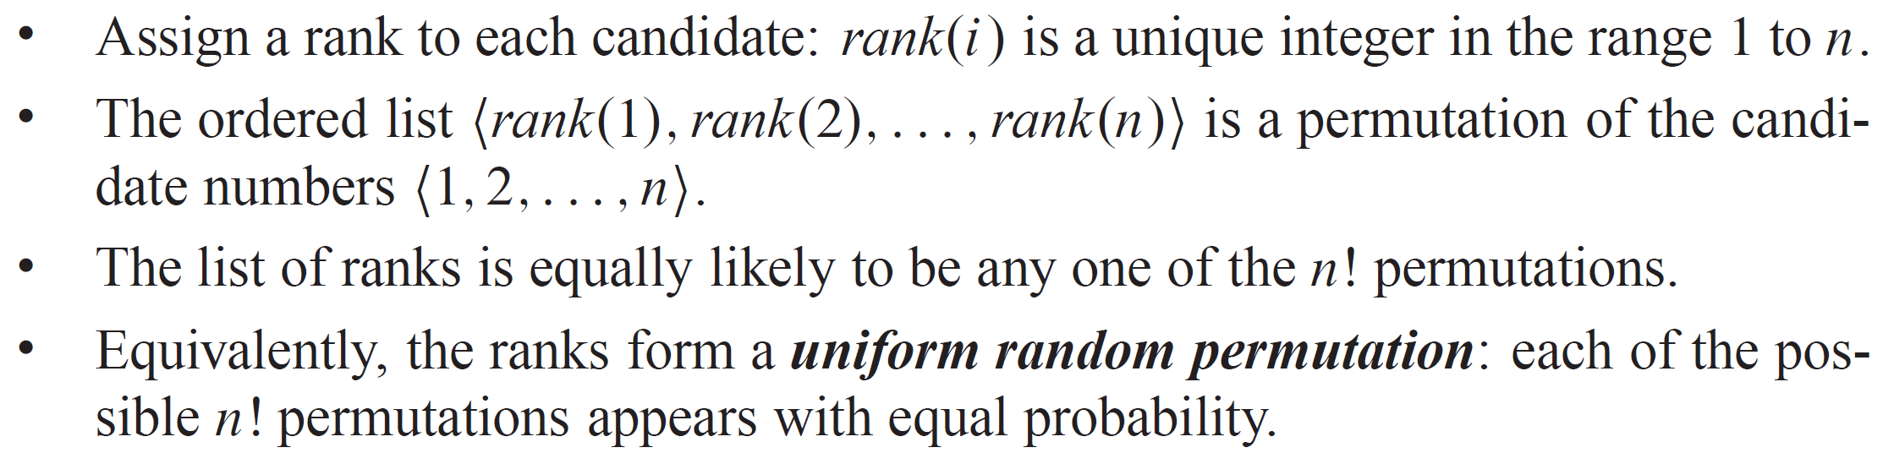
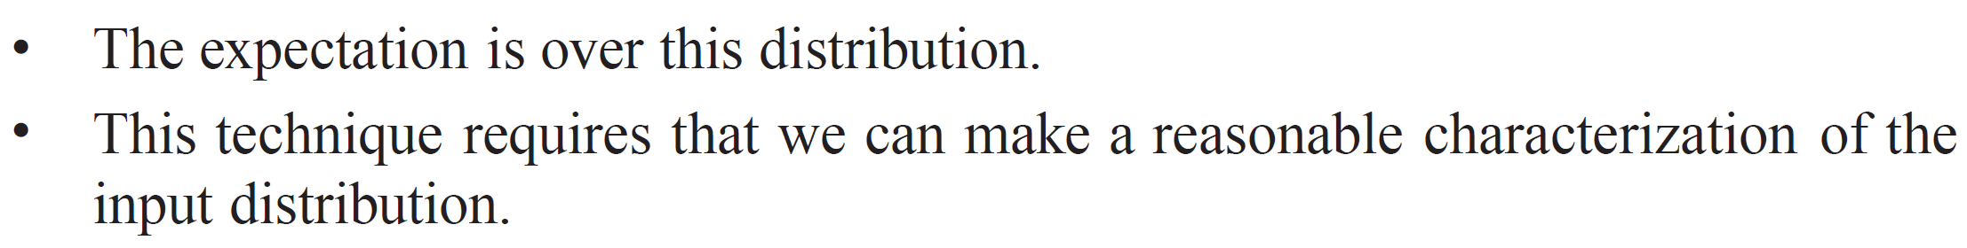
PROBABILISTIC ANALYSIS
In general, you have no control over the order in which candidates appear. We could assume that they come in a random order:

Slide 10
RANDOMIZED ALGORITHMS
Might not know the distribution of inputs, or might not be able to model it computationally. Instead, use randomization within the algorithm in order to impose a distribution on the inputs.
For the hiring problem:
Change the scenario:
The employment agency sends you a list of all n candidates in advance.
On each day, you randomly choose a candidate from the list to interview (but considering only those not yet interviewed).
Instead of relying on the candidates being presented in a random order, take control of the process and enforce a random order.

Slide 11
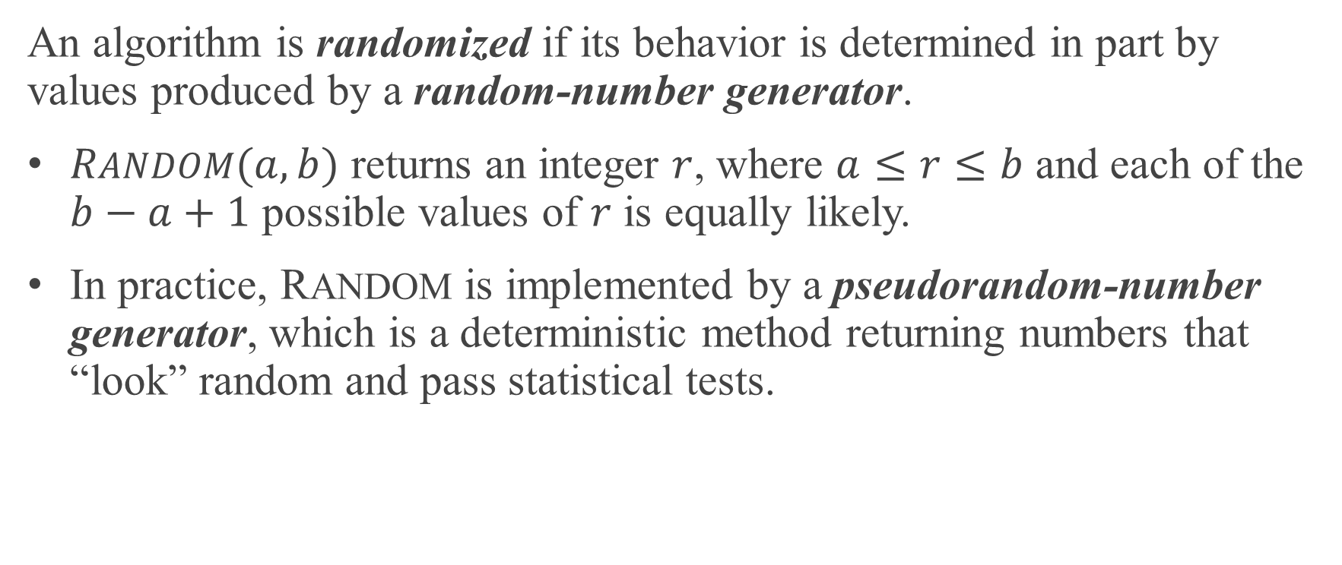
WHAT MAKES AN ALGORITHM RANDOMIZED
An algorithm is randomized if its behavior is determined in part by values produced by a random-number generator.
$RANDOM(a, b)$ returns an integer $r$, where $a≤r≤b$ and each of the $b−a+1$ possible values of $r$ is equally likely.
In practice, RANDOM is implemented by a pseudorandom-number generator, which is a deterministic method returning numbers that “look” random and pass statistical tests.

Slide 12
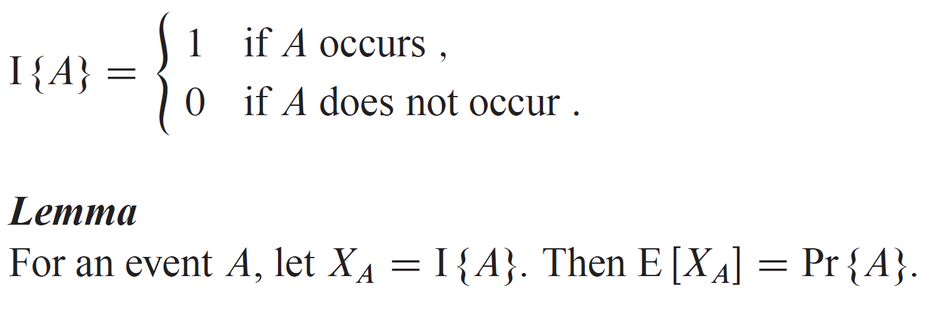
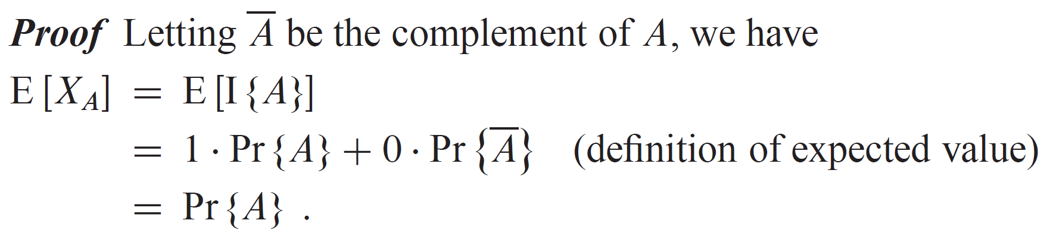

INDICATOR RANDOM VARIABLES
A simple yet powerful technique for computing the expected value of a random variable. Provides an easy way to convert a probability to an expectation. Helpful in situations in which there may be dependence. Given a sample space and an event $A$, define the indicator random variable

Slide 13
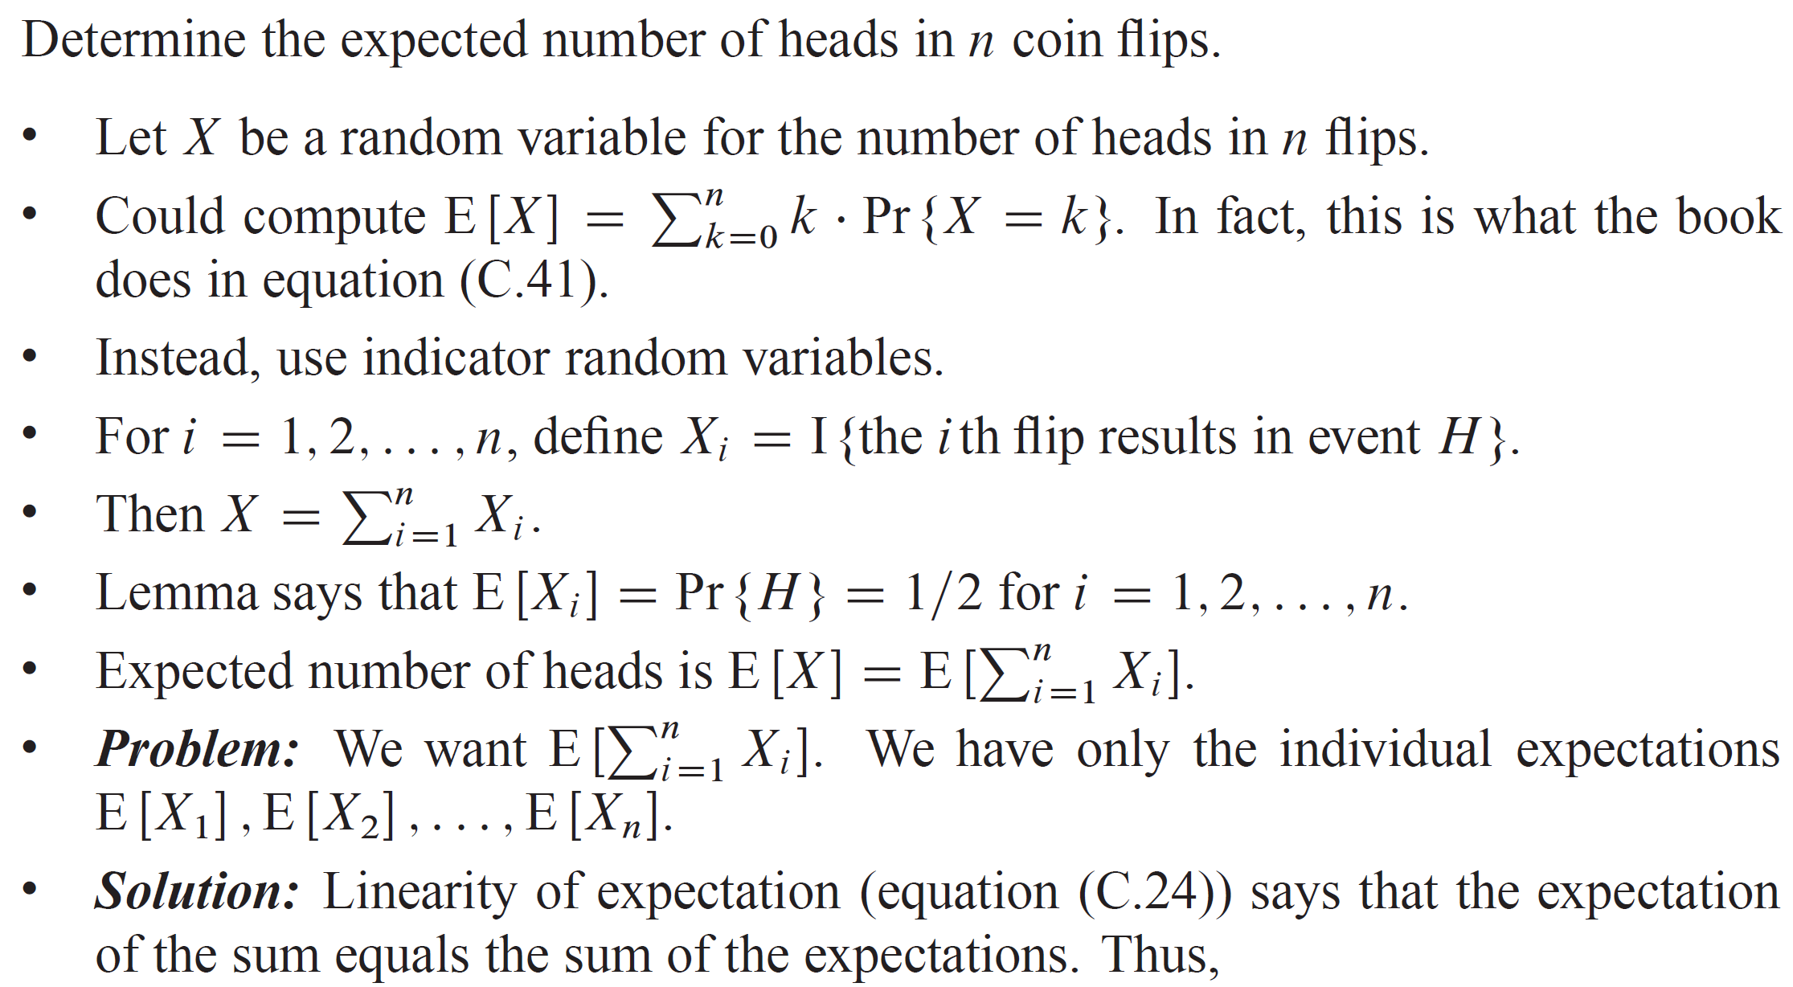
INDICATOR RANDOM VARIABLE EXAMPLE

Slide 14
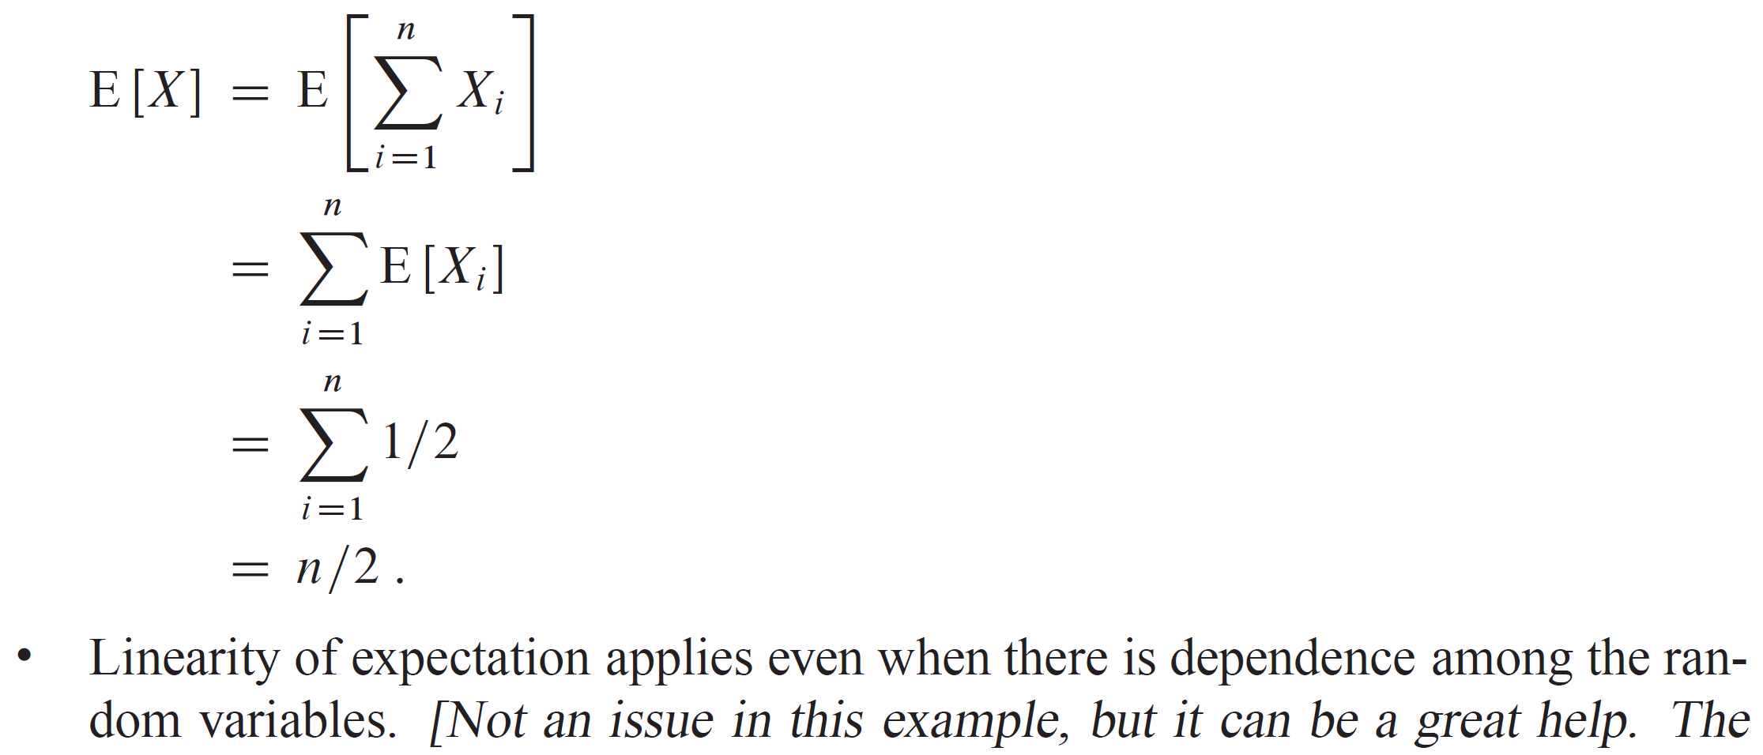
INDICATOR RANDOM VARIABLE EXAMPLE (continued)

Slide 15
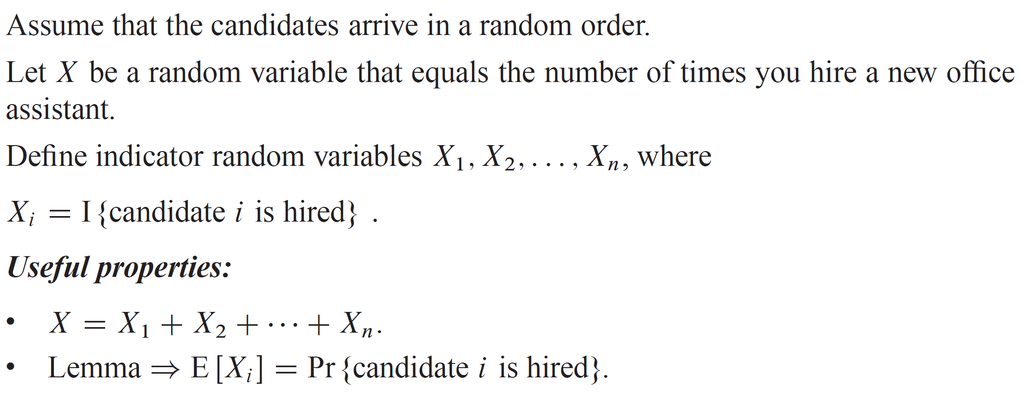
ANALYSIS OF THE HIRING PROBLEM

Slide 16
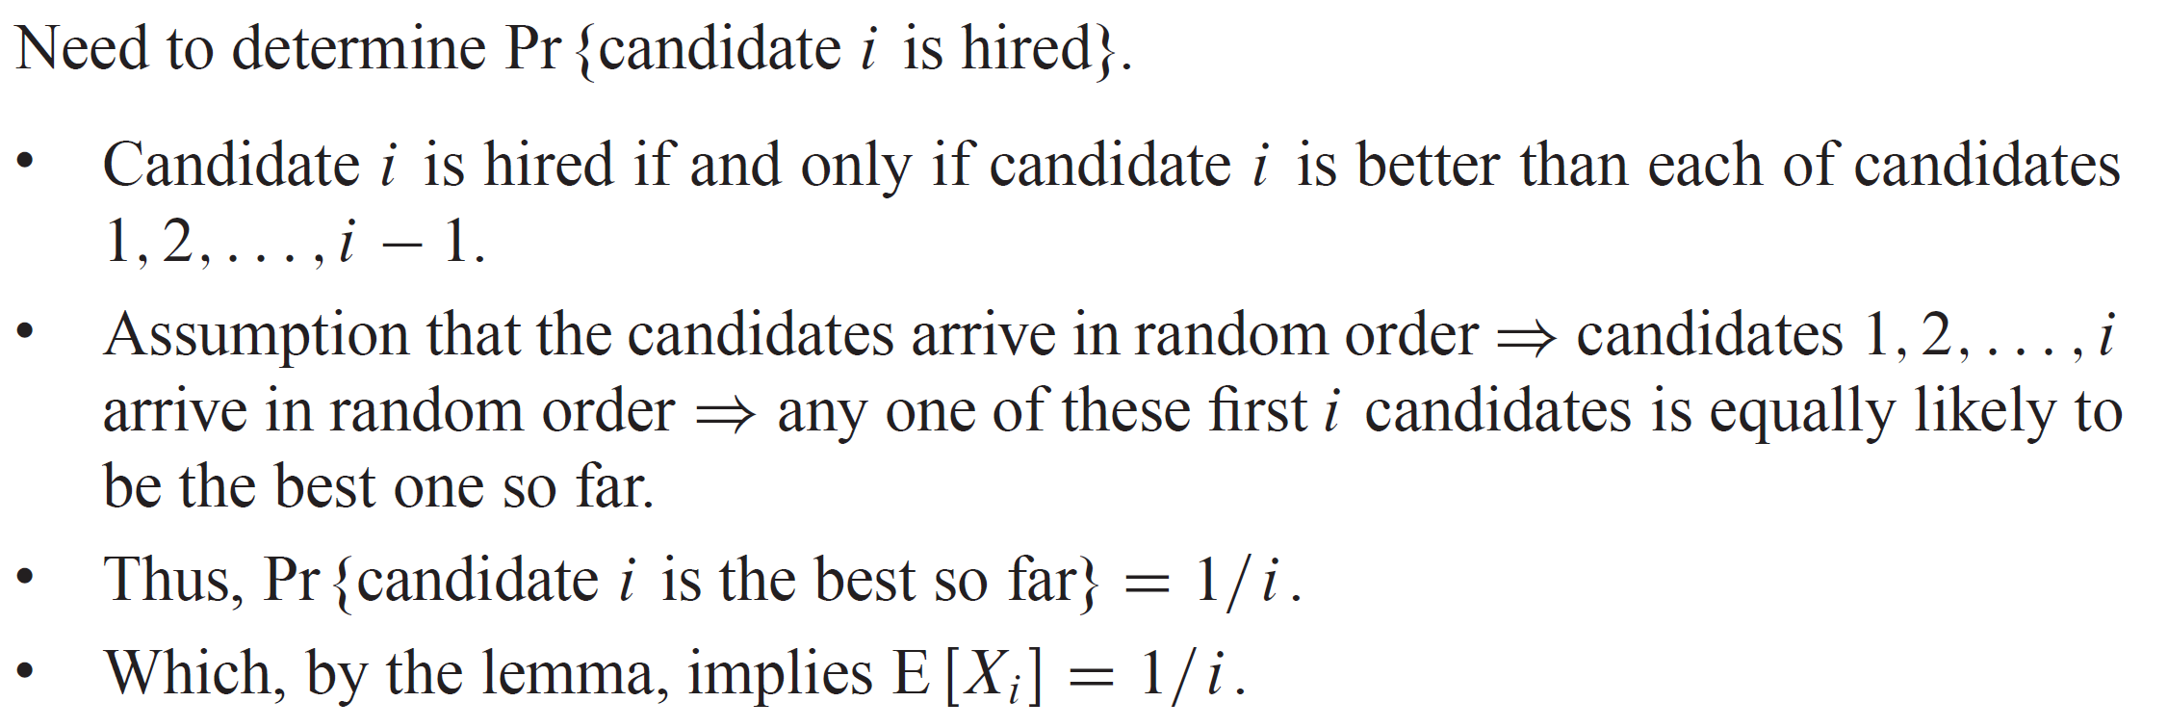
ANALYSIS OF THE HIRING PROBLEM (continued)

Slide 17
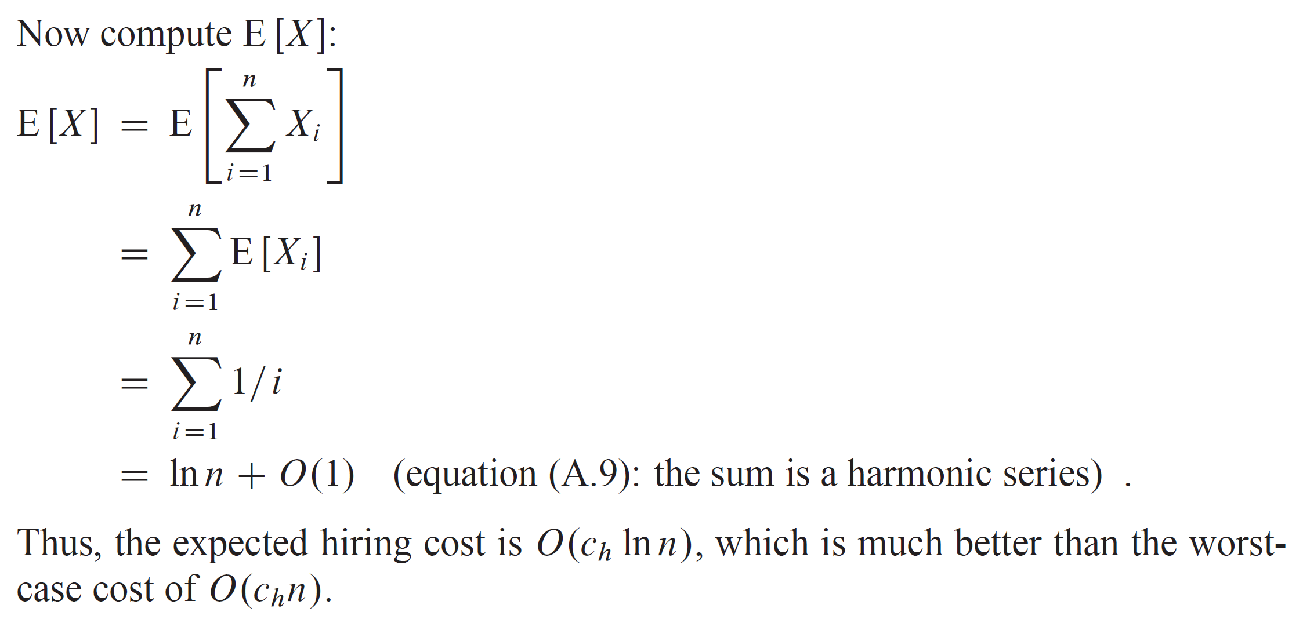
ANALYSIS OF THE HIRING PROBLEM (continued)

Slide 18
RANDOMIZED ALGORITHMS
Instead of assuming a distribution of the inputs, impose a distribution.
The hiring problem:
For the hiring problem, the algorithm is deterministic:
For any given input, the number of times you hire a new office assistant will always be the same.
The number of times you hire a new office assistant depends only on the input.
In fact, it depends only on the ordering of the candidates’ ranks that it is given.

Slide 19
RANDOMIZED ALGORITHMS (continued)
Instead of always interviewing the candidates in the order presented, what if you first randomly permuted this order?
The randomization is now in the algorithm, not in the input distribution.
Given a particular input, we can no longer say what its hiring cost will be. Each run of the algorithm can result in a different hiring cost.
In other words, in each run of the algorithm, the execution depends on the random choices made.
No particular input always elicits worst-case behavior.

Slide 20
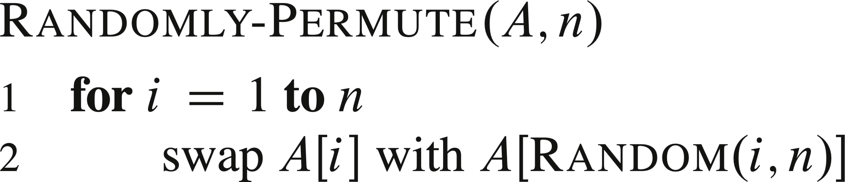
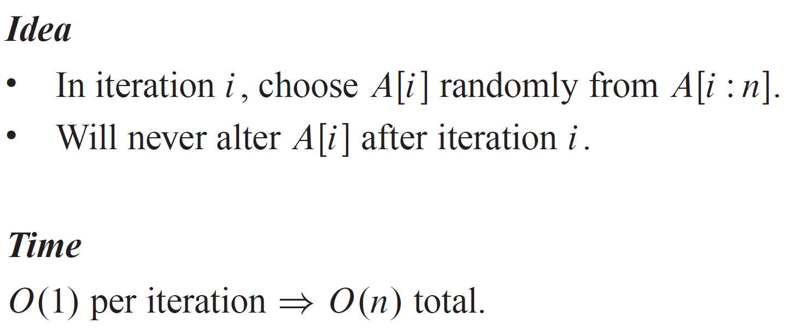
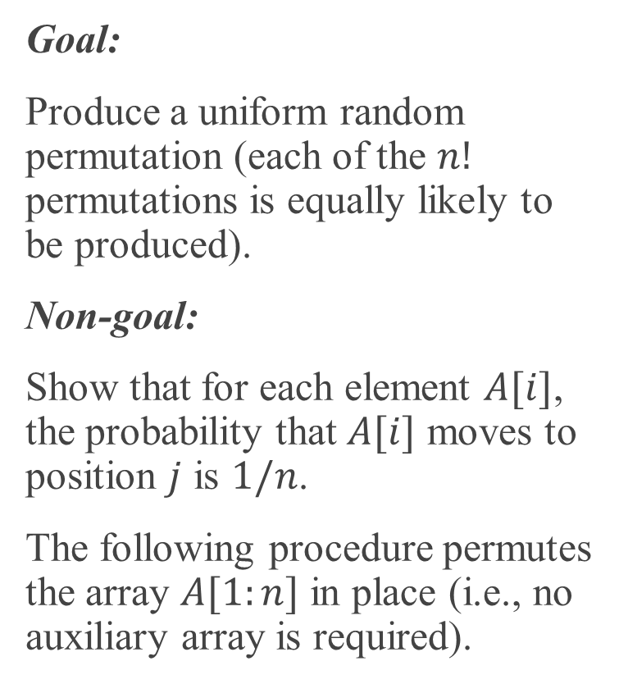
RANDOMLY PERMUTING AN ARRAY
Goal:
Produce a uniform random permutation (each of the $n!$ permutations is equally likely to be produced).
Non-goal:
Show that for each element $A[i]$, the probability that $A[i]$ moves to position $j$ is $1/n$.
The following procedure permutes the array $A[1:n]$ in place (i.e., no auxiliary array is required).

Slide 21
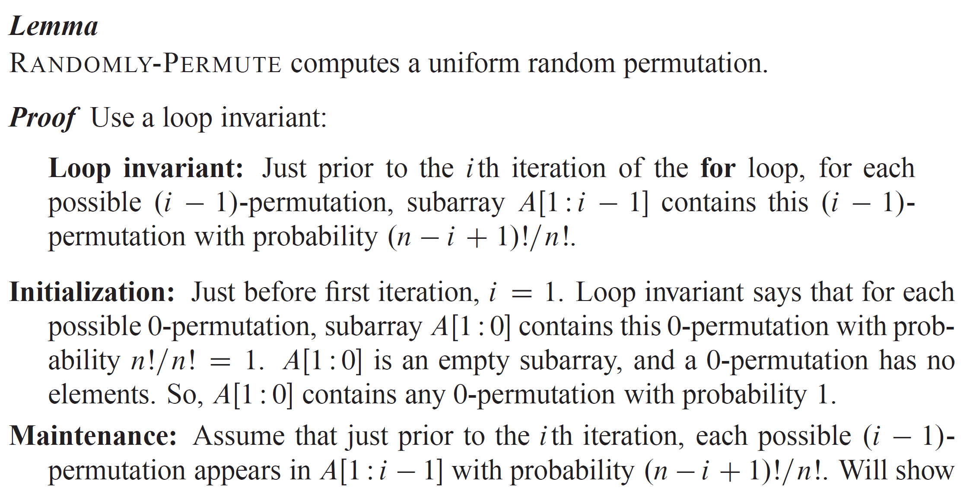
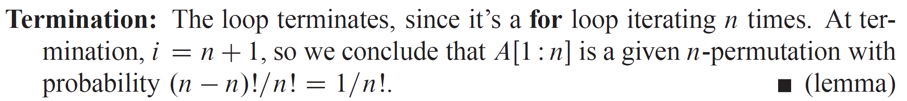
RANDOMLY PERMUTING AN ARRAY (continued)
Notes:
Note: Full details in textbook.

